Slide 1
Case Study of the Austrian Dam under the 1989 Loma Prieta Earthquake and its Implication to Seismic Analysis in BC
by
G. Wu, Ph.D., P. Eng. Wutec Geotechnical International A Presentation on 28th Vancouver Geotechnical Society Symposium
September 16, 2022
Pinnacle Hotel Vancouver
2022 VGS Symposium Presentation by Dr. G. Wu
Wutec Geotechnical International

Slide 2
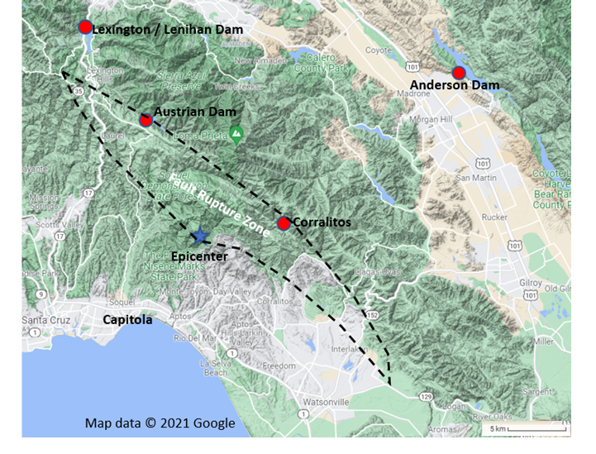
1. 1989 Loma Prieta Earthquake
The 1989 October 17 Loma Prieta earthquake fault rupture zone (Mw 6.93)
Ground motion recording stations (the Lexington station and the Corralitos station) and
Austrian Dam in California with a horizontal PGA 0.55-0.6 g (Harder et al. 1998)
2022 VGS Symposium Presentation by Dr. G. Wu
Case Study of the Austrian Dam under the 1989 Loma Prieta Earthquake

Slide 3
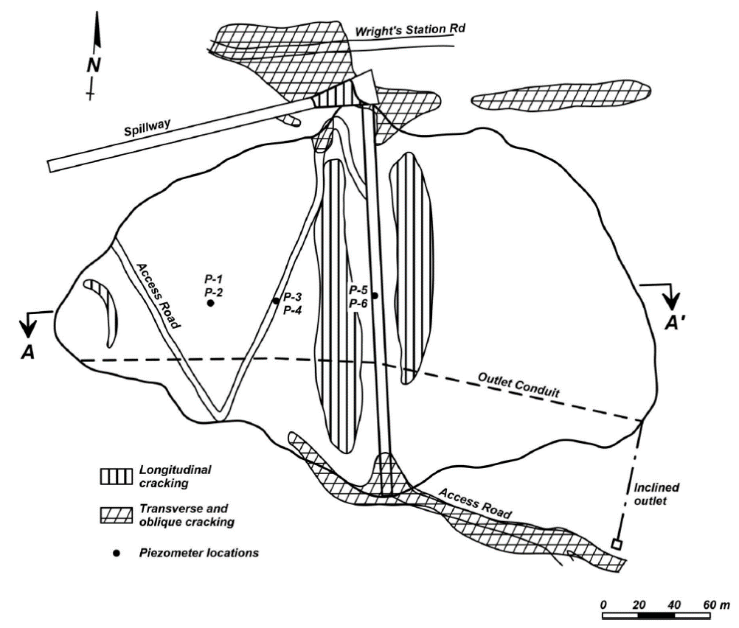
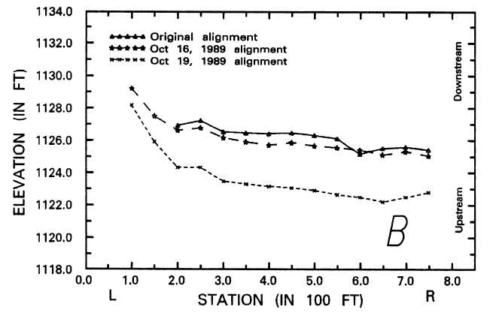
2. Austrian Dam and Performance in 1989 Loma Prieta EQ
PLAN VIEW (LEFT)
Damages by the earthquake:
Dam crest settled 0.76 m on average (Below)
Extensive longitudinal cracks (up to 300 mm wide)
Earthquake induced internal movements due to lateral spreading (Harder et al. 1998)
2022 VGS Symposium Presentation by Dr. G. Wu
Case Study of the Austrian Dam under the 1989 Loma Prieta Earthquake

Slide 4
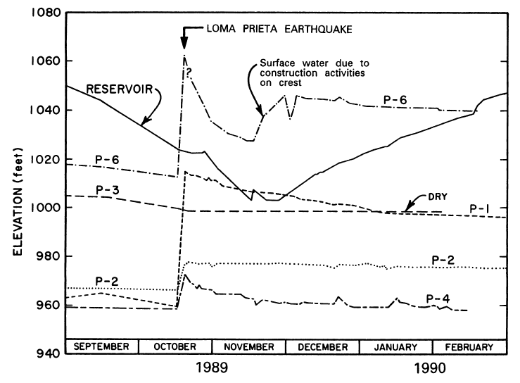
2. Austrian Dam and Performance in 1989 Loma Prieta EQ
2022 VGS Symposium Presentation by Dr. G. Wu
Case Study of the Austrian Dam under the 1989 Loma Prieta Earthquake
Shear deformations
MAXIMUM CROSS SECTION
Damages by the earthquake:
Rise of PWP in P-1, P-6, P-2, and P-3. PWP heads increased 15.2 m in P-6 and 16.8 m in P-1 two days after the EQ
Standpipe in piezometer P-1 significantly deformed at El. 291-293 m), suggesting earthquake induced internal movements due to lateral spreading (Harder et al. 1998)
P-6
P-1

Slide 5
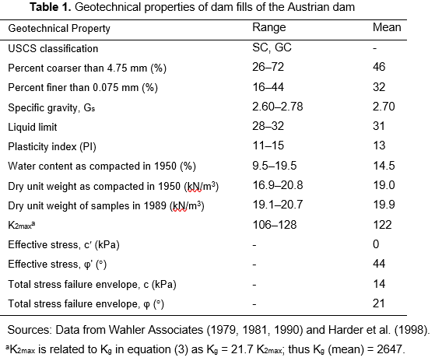
2. Austrian Dam – Soil Properties (Harder et al. 1989)
low plasticity clayey sands and clayey gravels
Shear strength of saturated fills:
Six ICU triaxial tests conducted in 1979
Effective stress strength parameters
c′ = 0
friction angle φ′= 44°
gravel
clay, silt
2022 VGS Symposium Presentation by Dr. G. Wu
Case Study of the Austrian Dam under the 1989 Loma Prieta Earthquake
Harder, L. F., Jr., J. D. Bray, R. L. Volpe, and K. V. Rodda. 1998. “Performance of earth dams during the Loma Prieta earthquake.” In US Geological Survey Professional Paper 1552-D, edited by T. L. Holzer, 3–26. Washington, USGS.

Slide 6
3. Dynamic Analysis Methods: Total Stress vs. Effective Stress
TOTAL STRESS APPROACH:
Earthquake induced PWP not calculated
Changes in effective stresses (σ′_{x}, σ′_{y}) during earthquake not calculated
Undrained shear strength, S_{u}, of saturated fills applied in dynamic analyses, and maintained during shaking
Su – depending on pre-earthquake consolidation stresses
Using a total stress model, e.g., VERSAT-clay model
EFFECTIVE STRESS APPROACH:
Earthquake induced PWPs are calculated
Changes in effective stresses (σ′_{x}, σ′_{y}) during earthquake are calculated and used in dynamic analyses
Effective stress strength parameters (c′, φ′) are used in dynamic analyses
Shear strengths change during shaking and are updated with new effective stresses
Using an effective stress model, e.g., VERSAT-sand, VERSAT-silt, PM4Sand and PM4Silt models
2022 VGS Symposium Presentation by Dr. G. Wu
Case Study of the Austrian Dam under the 1989 Loma Prieta Earthquake

Slide 7
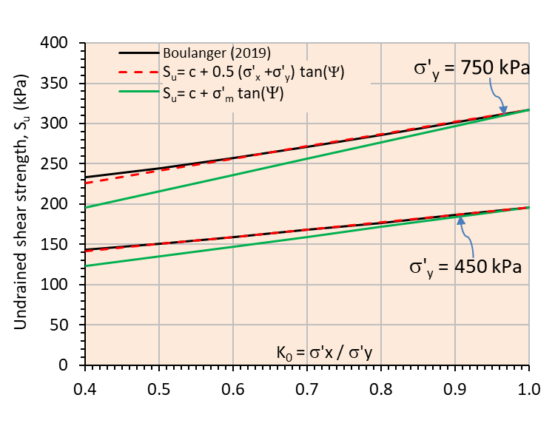
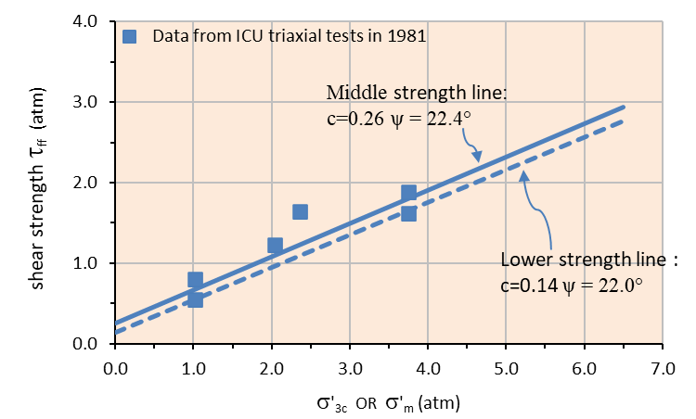
3. Dynamic total stress analysis using undrained shear strength, S_{u}
2022 VGS Symposium Presentation by Dr. G. Wu
Case Study of the Austrian Dam under the 1989 Loma Prieta Earthquake
Undrained shear strength of saturated fills, S_{u} = τ_{ff}:
where τ_{ff} = shear stress on the failure plane at failure, i.e., 0.5*(σ₁ - σ₃)/cos(φ′)
${σ^{′}}_{m}$= mean consolidation pressure or stress at the soil element center prior to earthquake loading;
${σ^{′}}_{y}$= effective vertical stress.
$S_{u}=c+ {σ^{′}}_{m}tan( )$
σ′_{m} = (σ'_{x} + σ'_{y} + σ'_{z}) / 3

Slide 8
3. Dynamic total stress analysis: VERSAT-2D finite element model
2022 VGS Symposium Presentation by Dr. G. Wu
Case Study of the Austrian Dam under the 1989 Loma Prieta Earthquake
VERSAT-2D finite element model with finite element grids, soil and rock zones, reservoir water level and phreatic surface
7258 nodes and 7072 elements
Static stress analysis:
building the dam in layers
5 m thick each layer, vertically consisting of five 1-m high soil elements in the layer and horizontally including all elements across the dam
The stress-level dependent elasticity moduli (soil stiffness) are updated after each 5-m thick layer is added onto the model.
Add reservoir water and hydrostatic pore water pressures in the dam

Slide 9
3. Dynamic total stress analysis: S_{u} distribution in saturated fills
Effective vertical stress, σ'_{y.}
2022 VGS Symposium Presentation by Dr. G. Wu
Case Study of the Austrian Dam under the 1989 Loma Prieta Earthquake
S_{u}-ratio = S_{u}/σ’_{y.}
using c = 14 kPa, Ψ = 22°

Slide 10
3. Dynamic total stress analysis: input ground motions
Austrian Dam:
a closest distance to surface projection of coseismic rupture (R_{jb})=0.16 km
a closest distance to coseismic rupture (R_{rup}) = 3.85 km,
Rx = +0.16 km
GROUND MOTION RECORDING STATIONS:
Lexington dam station (now Lenihan Dam): 0.41g in 90°, 0.44g in 0°, 0.14 g vertical
a foot-wall site, and it had R_{jb} = 3.22 km and R_{rup} = 5.02 k, and Rx = -3.22 km (PEER 2021)
The Lexington motions were scaled up by 1.36 that was obtained
using NGA West2 ground motion prediction equations (GMPE).
After scaling, PGAs = 0.55g in 90°, 0.60g in 0°, 0.19g vertical. This is consistent with estimate by seismologist in 1998 (Harder et al. 1998)
2022 VGS Symposium Presentation by Dr. G. Wu
Case Study of the Austrian Dam under the 1989 Loma Prieta Earthquake

Slide 11
3. Dynamic total stress analysis: input ground motions
Corralitos station: same R_{jb,} R_{rup} as Austrian dam, but Rx = - 0.16 km (PEER 2021)
Rx, which is negative for footwall sites and positive for hanging wall sites.
Expert: because these Rx values are small, the ground motions at these two sites are not expected to be significantly affected by the fact that one site is on the footwall and the other site is on the hanging wall.
No scaling was applied to Corralitos motions .
PGAs = 0.48g (90°), 0.64g (0°), 0.46g (V) with a high vertical motions. This input motion was used by Boulanger (2019) in his FLAC analysis of the Austrian dam using PM4silt
2022 VGS Symposium Presentation by Dr. G. Wu
Case Study of the Austrian Dam under the 1989 Loma Prieta Earthquake

Slide 12
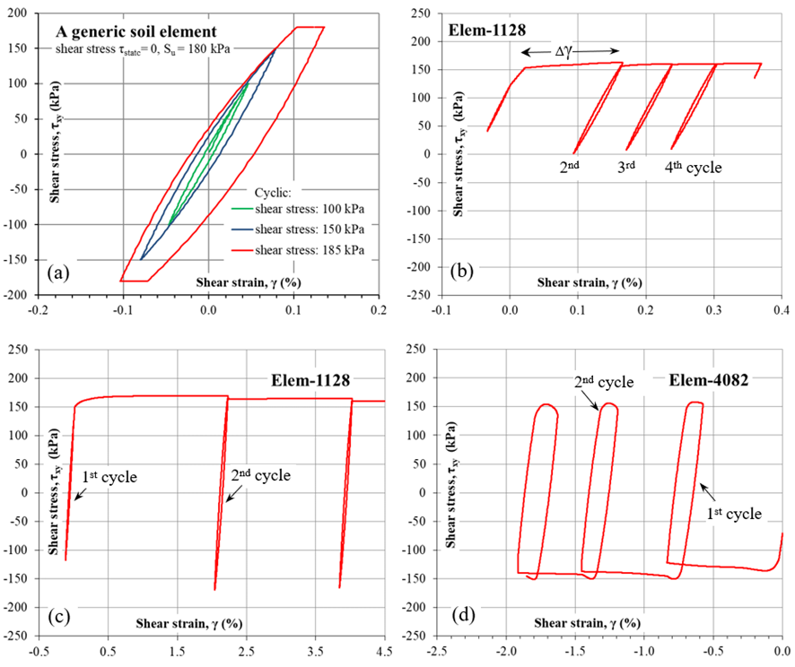
3. Dynamic total stress analysis: VERSAT–clay model
Shear stress-strain response of saturated dam fills in constant shear stress amplitude cyclic (sine wave) loading:
for a generic soil element at three stress levels;
for soil element 1128 under the 0.1g input accelerations;
for soil element 1128 under 0.3g
for soil element 4082 under the 0.3g input accelerations.
2022 VGS Symposium Presentation by Dr. G. Wu
Case Study of the Austrian Dam under the 1989 Loma Prieta Earthquake

Slide 13
3. Dynamic total stress analysis: VERSAT results
contours of vertical displacements, DISP-Y (m)
2022 VGS Symposium Presentation by Dr. G. Wu
Case Study of the Austrian Dam under the 1989 Loma Prieta Earthquake
contours of abs. shear strain %

Slide 14
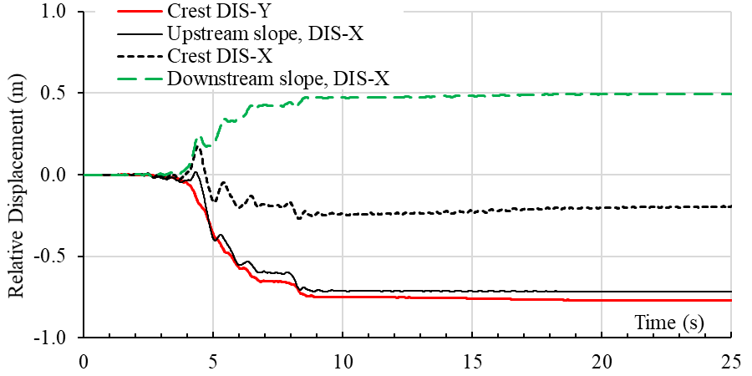
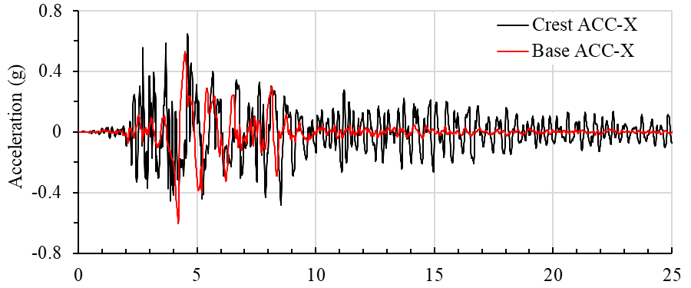
3. Dynamic total stress analysis: VERSAT results
TIME HISTORY RESPONSE
Displacements at dam crest and on upstream and downstream slope
Accelerations at dam crest & input base accelerations
2022 VGS Symposium Presentation by Dr. G. Wu
Case Study of the Austrian Dam under the 1989 Loma Prieta Earthquake

Slide 15
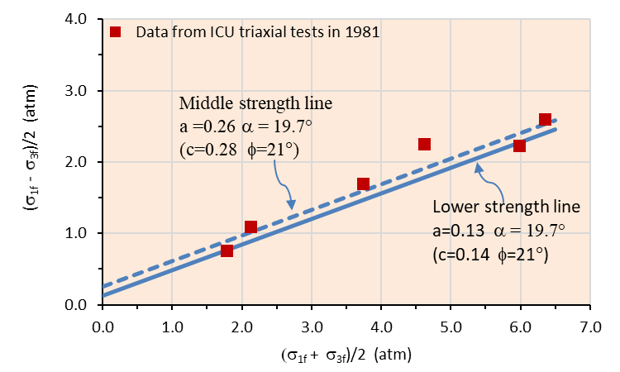
3. Dynamic total stress analysis: using c-phi approach
2022 VGS Symposium Presentation by Dr. G. Wu
Case Study of the Austrian Dam under the 1989 Loma Prieta Earthquake
Total stress envelope approach, i.e., total stress envelope parameters (c, φ)
c = 14 kPa
φ = 21°

Slide 16
3. Dynamic total stress analysis: using c-phi approach
Abs. shear strain %
2022 VGS Symposium Presentation by Dr. G. Wu
Case Study of the Austrian Dam under the 1989 Loma Prieta Earthquake
Post-earthquake Austrian dam calculated using the total stress envelope c-φ approach with the CLS-00° input accelerations:
contours of absolute shear strains (%); and
deformed dam configuration showing dam crest settlement of 2.4 m.

Slide 17
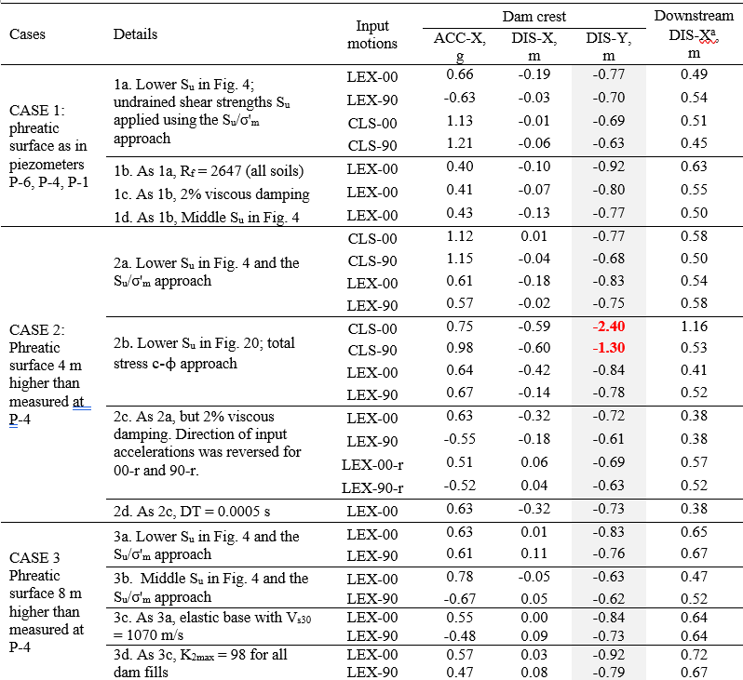
3. Dynamic total stress analysis: results of parametric runs
2022 VGS Symposium Presentation by Dr. G. Wu
Case Study of the Austrian Dam under the 1989 Loma Prieta Earthquake

Slide 18
4. Summary
Dynamic responses of the Austrian dams in the 1989 Mw = 6.93 Loma Prieta earthquake (Harder et al. 1998) were analyzed using the finite element program VERSAT-2D (Wu 2001, 2015; Finn and Wu 2013).
Undrained response of the saturated dam fills was modelled using a total stress approach. The dam was constructed in the early 1950s and comprised primarily of compacted low plasticity clayey sands and clayey gravels. Subjected to estimated peak accelerations of 0.55-0.6g, the dam developed extensive longitudinal cracks on the dam faces and settled at its crest 0.76 m on average.
2022 VGS Symposium Presentation by Dr. G. Wu
Case Study of the Austrian Dam under the 1989 Loma Prieta Earthquake

Slide 19
4. Summary
This case study demonstrates the robustness of using the total stress approach and its capability in capturing the key features of embankment dam’s earthquake performance, even in large earthquakes.
The nonlinear response history analyses indicate that the proposed S_{u}/σ'_{m} approach for calculating in-situ undrained shear strengths can be a reasonably conservative approach for engineering analysis and design. The calculated dam crest settlements for the dam are in good agreement with the dam crest settlements observed in the 1989 earthquake.
The total stress approach (VERSAT-2D): Capable of capturing the mechanism of dam deformations, i.e., large shear strains occurred near the bottom of the dam slopes.
It is suggested by the study that the total stress envelope (c-φ) approach be avoided whenever possible for dynamic analysis of dams and be excluded if large vertical input accelerations are present.
2022 VGS Symposium Presentation by Dr. G. Wu
Case Study of the Austrian Dam under the 1989 Loma Prieta Earthquake

Slide 20
5. Reference
Boulanger, R. W. 2019. “Nonlinear dynamic analyses of Austrian Dam in the 1989 Loma Prieta earthquake.” J. Geotech. Geoenviron. Eng. 145 (11).
Finn W. D. L and G. Wu. 2013. “Dynamic analyses of an earthfill dam on over-consolidated silt with cyclic strain softening.” In Proc., 7th Int. Conf. on Case Histories in Geotechnical Engineering, Keynote paper, edited by S. Prakash. Chicago.
Harder, L. F., Jr., J. D. Bray, R. L. Volpe, and K. V. Rodda. 1998. “Performance of earth dams during the Loma Prieta earthquake.” In US Geological Survey Professional Paper 1552-D, edited by T. L. Holzer, 3–26. Washington, USGS.
Wu, G. 2001. “Earthquake induced deformation analyses of the Upper San Fernando dam under the 1971 San Fernando earthquake.” Can. Geotech. J. 38 (1): 1-15.
Wu, G. 2015. “Seismic design of dams.” In Encyclopedia of Earthquake Engineering, Berlin Heidelberg, Germany: Springer-Verlag
WGI (Wutec Geotechnical International). 2019. VERSAT-2D v.2019: A computer program for 2-dimensional static and dynamic finite element analysis of continua. BC, Canada: WGI
WGI (Wutec Geotechnical International). 2022. Finite Element Dynamic Analyses of Austrian Dam. Engineering Report No. WGI-220224 (100 pages) http://wutecgeo.com/publication.aspx
2022 VGS Symposium Presentation by Dr. G. Wu
Case Study of the Austrian Dam under the 1989 Loma Prieta Earthquake

Slide 21
THANK
YOU !!
谢谢!!
2022 VGS Symposium Presentation by Dr. G. Wu
Wutec Geotechnical International
Contact:
G. Wu, Ph.D., P. Eng.
Wutec Geotechnical International
406 – 615 Hamilton Street
New Westminster, Metro Vancouver B.C., Canada, V3M 7A7
Email: gwu@wutecgeo.com Website: http://www.wutecgeo.com

